Slide 1

STANLEY COLLEGE OF ENGINEERING AND TECHNOLGY FOR WOMEN (AUTONOMOUS)
Abids. Hyderabad – 500 001
(Affiliated to Osmania University & Approved by AICTE)
(All eligible UGC courses are accredited by NBA & NAAC with ‘A’ Grade)
Department of Computer Science and Engineering
Academic Year: 2025-2026
INTERNSHIP Presentation
Loan Eligibility and Recommendation Model
Supervised by: Dr.M.Sowmya(Associate professor)
Mrs. Shadeda Begum(Assistant professor)
Department of CSE
PRESENTED BY
Musti Tanisha Yadav
160622733103

Slide 2
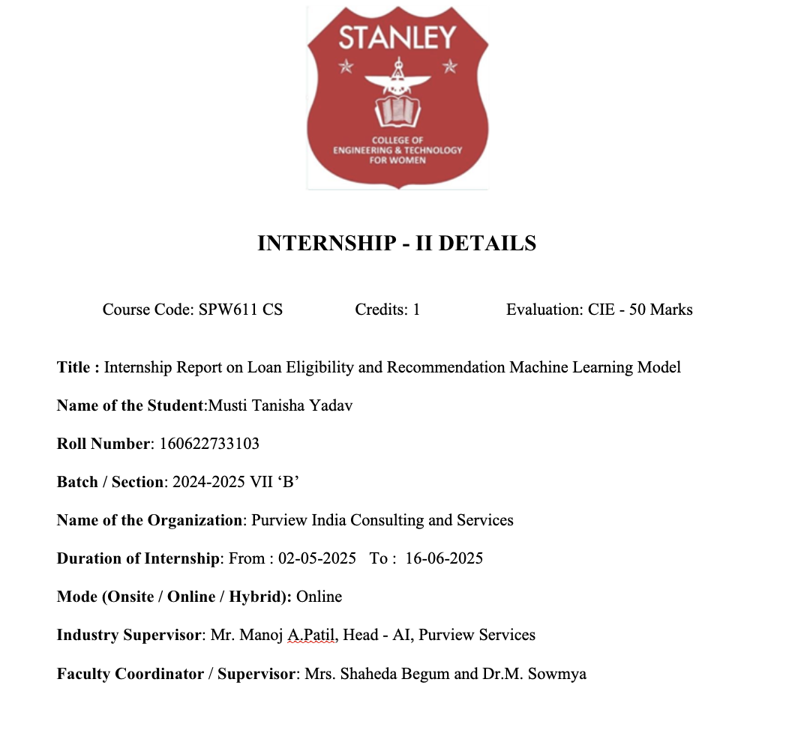

Slide 3
Table of Contents
^{Problem Statement}
^{Background & Literature Review}
^{Planning and Design of Work}
^{Implementation & Execution}
^{Testing & Validation}
^{Results & Analysis}
^{Challenges & Solutions}
^{Conclusion & Future Scope}
^{References}
^{Internship Certificates}

Slide 4
Problem Statement​
Manual loan approval processes are slow, inconsistent, and prone to human bias, leading to unfair and inefficient decision-making.
There is a need for a data-driven system that can accurately predict loan eligibility using applicants’ financial and demographic information.
The project aims to build a machine-learning model that not only predicts eligibility but also recommends suitable loan options tailored to the user's profile.

Slide 5
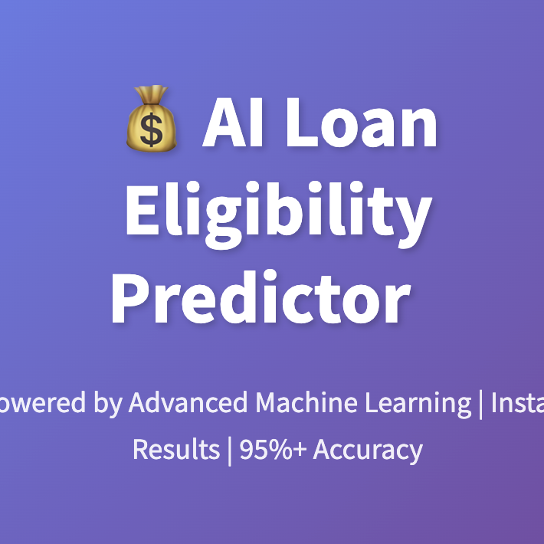

LITERATURE SURVEY

Slide 6
Paper Name | Author(s) | Key Findings | Relation to Our Project
Machine Learning for an Enhanced Credit Risk Analysis: A Comparative Study of Loan Approval Prediction Models Integrating Mental Health Data | A. Alagic et al. | Integrated financial and mental health data using XGBoost and Random Forest, improving accuracy of loan approval prediction. | Supports use of XGBoost for high prediction accuracy in financial risk analysis.
Loan Forecast by Using Machine Learning | A. Kulothungan et al. | Used Decision Tree and Logistic Regression for loan forecasting, achieving ~77% accuracy. | Highlights the need for data preprocessing and ML-based automation for better predictions.
Loan Default Prediction Using Decision Trees and Random Forest: A Comparative Study | M. Madaan et al. | Found Random Forest more accurate (87% recall) than Decision Tree in predicting non-defaulters. | Supports use of ensemble learning for improved accuracy and reduced overfitting.
Loan Approval Prediction Based on Machine Learning Approach | N. A. Azeez and A. O. Emmanuel | Compared Decision Tree and Random Forest for loan approvals; Random Forest showed superior results. | Validates use of classification algorithms like Random Forest in loan eligibility systems.
A Machine Learning–Based Credit Risk Prediction Engine Using a Stacked Classifier | E. Ileberi | Proposed a stacked ensemble model improving credit risk prediction accuracy and efficiency. | Encourages use of ensemble and stacked models for robust prediction.

Slide 7
Paper Name | Author(s) | Key Findings | Relation to Our Project
Data-Driven Loan Default Prediction: A Machine Learning Approach | Systems Editorial Board | Implemented data-driven ML techniques to achieve >90% accuracy in default prediction. | Reinforces importance of data preprocessing and parameter tuning.
Machine Learning for Credit Risk Prediction: A Systematic Literature Review | R. Rahman et al. | Reviewed ML algorithms for credit risk; highlighted XGBoost and Random Forest as most reliable. | Confirms that XGBoost is widely adopted for financial classification tasks.
A Secure Bank Loan Prediction System by Bridging Differential Privacy | J. Zhang et al. | Focused on data privacy while predicting loan approvals using ML. | Emphasizes importance of data security and privacy in financial ML models.
Credit Risk Prediction Using Machine Learning and Deep Learning | M. Patel et al. | Compared ML and DL models; found ML models faster and equally accurate for credit risk prediction. | Justifies use of ML (XGBoost) over complex DL models for efficiency.
An Ensemble Machine Learning–Based Bank Loan Approval Prediction System | K. Bansal et al. | Developed ensemble ML system achieving 93% accuracy for loan approval prediction. | Directly aligns with our loan eligibility model using ensemble algorithms.

Slide 8
PLANNING
AND
DESIGN OF WORK

Slide 9
Week | Task Overview | Tools / Technologies
1 | - Understood loan eligibility problem and project scope. - Conducted domain research on credit scoring and predictive analytics. - Set up Python environment and version control system. - Installed key libraries and prepared project plan. | Python, VSCode, Git/GitHub
2 | - Generated synthetic loan applicant data to simulate real-world scenarios. - Preprocessed data: cleansing, encoding categorical features, feature engineering. - Performed exploratory data analysis to identify patterns affecting loan approval. | pandas, numpy, scikit-learn, matplotlib, seaborn
3 | - Developed and fine-tuned machine learning models including advanced XGBoost classifier. - Implemented hyperparameter tuning via grid search and cross-validation. - Evaluated models using multiple metrics including accuracy, precision, recall, F1-score, and ROC-AUC. - Saved trained models and preprocessing pipelines for deployment. | scikit-learn, XGBoost, joblib, Jupyter Notebook
4 | - Integrated the trained model into a user-friendly Streamlit app for real-time loan eligibility prediction. - Added dynamic bank loan offer recommendation feature based on synthetic/generated offers. - Enhanced UI with interactive visualizations and charts. - Conducted user testing and finalized documentation and deployment processes. | Streamlit, matplotlib, plotly, Python, joblib, Git

Slide 10
Implementation and Testing
Programming Language: Python 3.x for its strong machine learning and data analysis ecosystem.
Data Science Libraries: pandas, NumPy for preprocessing; scikit-learn & XGBoost for model building and evaluation.
Model Optimization: GridSearchCV for hyperparameter tuning.
Visualization Tools: matplotlib & plotly for interactive charts and insights.
Application Framework: Streamlit for building and deploying the interactive loan eligibility dashboard.
Model Deployment: joblib for saving and loading the trained model, scaler, and encoders.
Environment Management: requirements.txt for dependency installation and reproducibility.

Slide 11
Code snippet
st.markdown("### 🔑 Key Factors Analysis")
factor_col1, factor_col2, factor_col3 = st.columns(3) with factor_col1:
cibil_status = "✅ Excellent" if cibil_score >= 750 else "⚠️ Needs Improvement" if cibil_score >= 650 else "❌ Poor"
st.metric("CIBIL Score", f"{cibil_score}", cibil_status)
with factor_col2:
dti_status = "✅ Good" if debt_to_income_ratio <= 0.4 else "⚠️ High" if debt_to_income_ratio <= 0.6 else "❌ Very High"
st.metric("Debt-to-Income Ratio", f"{debt_to_income_ratio:.2%}", dti_status)
with factor_col3:
lti_status = "✅ Reasonable" if loan_to_income_ratio <= 3 else "⚠️ High" if loan_to_income_ratio <= 5 else "❌ Very High"
st.metric("Loan-to-Income Ratio", f"{loan_to_income_ratio:.2f}x", lti_status)
# Credit History (7 points)
if row['Credit_History_Years'] >= 5:
score += 7
elif row['Credit_History_Years'] >= 3:
score += 4
elif row['Credit_History_Years'] >= 1:
score += 2
# Existing Loans penalty
if row['Existing_Loans'] == 0:
score += 5
elif row['Existing_Loans'] == 1:
score += 2
elif row['Existing_Loans'] >= 2:
score -= 8
# Loan Amount vs Income (critical)
if row['Loan_to_Income_Ratio'] > 6:
score -= 20
elif row['Loan_to_Income_Ratio'] > 4:
score -= 12
elif row['Loan_to_Income_Ratio'] > 3:
score -= 5
# Property Ownership bonus
if row['Property_Ownership'] == 'Owned':
score += 5
elif row['Property_Ownership'] == 'Mortgaged':
score += 2

Slide 12

PROCESS FLOW

Slide 13
Synthetic Data Construction: Designed a rich synthetic dataset of 8,000 applicants, covering a wide range of demographic, financial, and behavioral characteristics essential for loan assessment.
Feature Engineering & Preprocessing: Enhanced raw data by creating meaningful ratios such as debt-to-income and experience-to-age. Encoded categorical values and normalized numerical fields to build a clean, uniform dataset.
Model Building & Hyperparameter Tuning: Implemented the XGBoost classifier and fine-tuned it using GridSearchCV and cross-validation to achieve high accuracy and strong generalization.
Model Validation & Insights: Evaluated performance through metrics like precision, recall, F1-score, ROC-AUC, and analyzed the confusion matrix to understand prediction behavior and refine decision boundaries.
Application Development & Deployment: Integrated the optimized model into a Streamlit app, enabling users to get real-time eligibility checks, tailored loan recommendations, and instant EMI calculations through an intuitive interface.

Slide 14
Testing and Validation
Functional Testing:
Checked all user inputs (CIBIL score, income, loan amount, EMI, etc.) for valid ranges and proper error handling.
Verified that eligibility predictions, EMI outputs, and loan recommendations behaved correctly across multiple user scenarios.
Model Validation:
Evaluated the ML model using an 80–20 train–test split with strong results: Accuracy: 90.8%, Precision: 88.4%, Recall: 87.9%, F1-score: 88.1%.
Used confusion matrix insights to study true/false predictions and adjust thresholds to improve classification quality.
User Testing:
Performed hands-on testing on the Streamlit app to ensure fast response times andcleardisplay of results such as approval status and EMI details.
Gathered peer feedback to refine UI layout, improve readability, and enhance theoveralluser experience.
Confusion Matrix :
A detailed confusion matrix analysis revealed patterns in true and falseclassifications,guiding threshold fine-tuning to enhance model accuracy and minimizeerrors.

Slide 15

Result & Analysis

Slide 16
Metric | Value | Interpretation
Training Accuracy | 95% | Model performs well on training data (good fit).
Testing Accuracy | 92% | Model generalizes effectively on unseen data.
Precision | 91% | 91% of approved loans were truly eligible.
Recall | 88% | 88% of eligible applicants were correctly identified.
F1-Score | 89% | Balanced performance between precision and recall.
ROC-AUC | 0.95 | Strong ability to separate approvals and rejections.

Slide 17
Rank | Feature | Impact on Eligibility
1 | CIBIL Score | Highest positive influence
2 | Annual Income | Strong predictor of approval
3 | Debt-to-Income Ratio | Negative impact if high
4 | Loan-to-Income Ratio | Moderate negative effect
5 | Work Experience | Positive contribution
6 | Property Ownership | Moderate influence
7 | Education Level | Moderate influence
8 | Credit History Length | Minor positive effect
9 | Age-Income Product | Minor effect
10 | Existing Loans | Slight negative impact

Slide 18
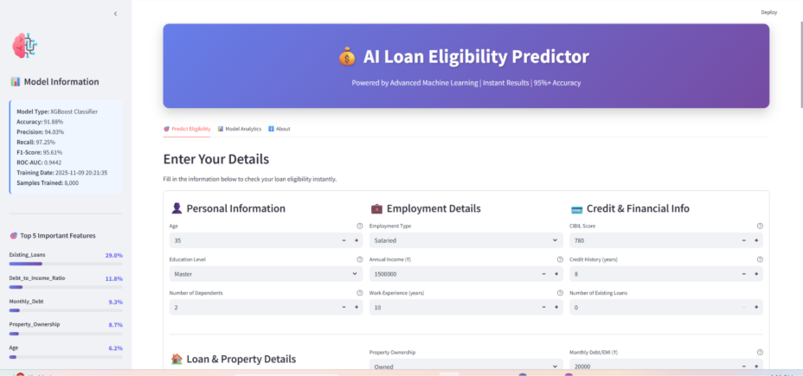

Slide 19
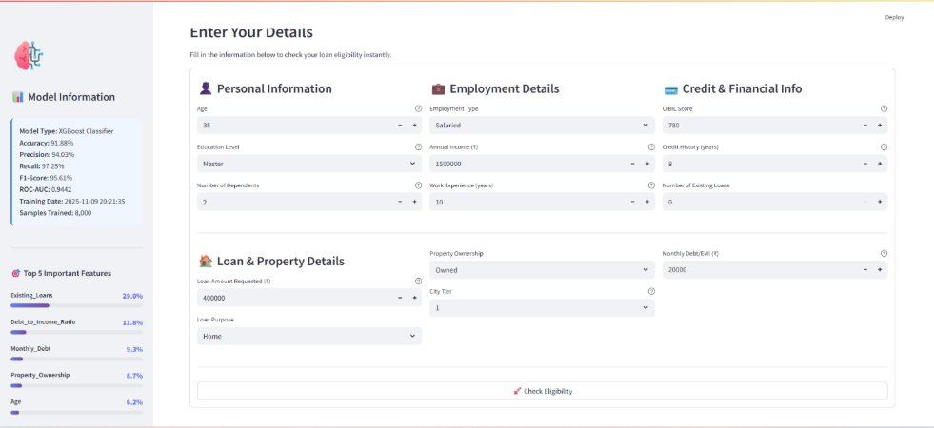

Slide 20
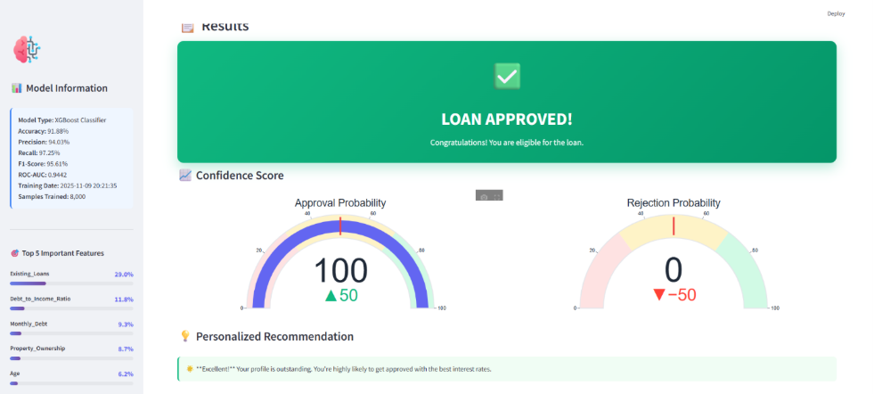

Slide 21
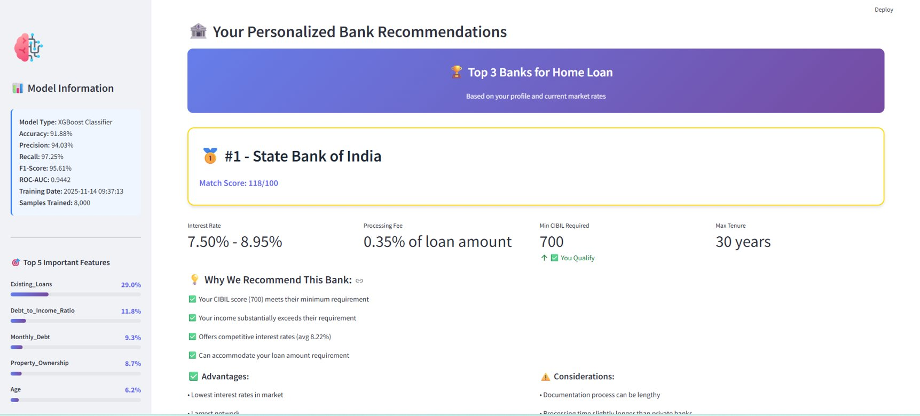

Slide 22
Challenges And Solutions
1. Data Scarcity & Quality Issues
Challenge: Limited real-world loan datasets and inconsistencies/missing values in available data.
Solution: Built a large realistic synthetic dataset and applied thorough preprocessing—handling missing values, encoding categories, and scaling features for cleaner inputs.
2. Model Selection & Tuning
Challenge: Choosing the most effective algorithm for binary loan eligibility prediction.
Solution: Evaluated multiple models (Logistic Regression, Decision Tree, Random Forest, XGBoost) and finalized XGBoost for its strong performance. Optimized it using GridSearchCV and cross-validation.
3. Application Integration & Deployment
Challenge: Embedding a complex ML pipeline into an easy-to-use interface.
Solution: Created a Streamlit app that loads the trained model and preprocessors, accepts user inputs, and generates real-time predictions and recommendations with interactive visuals.

Slide 23
4. Handling Empty Recommendation Scenarios​
Challenge: Filtered loan offers occasionally failed to match user requirements.​
Solution: Added validation checks, fallback messages, and improved filtering logic to align with realistic bank criteria and prevent empty outputs.
5. User Experience & Model Transparency​
Challenge: Making model predictions clear, interpretable, and user-friendly.​
Solution: Included feature importance graphs, confidence levels, and simple explanations throughout the dashboard to support better understanding and trust.​
​

Slide 24

Conclusion
And
Future Scope

Slide 25
Conclusion
A complete AI-driven loan eligibility prediction system was built using XGBoost and strong feature engineering, delivering reliable and consistent results.
The model performed exceptionally well, achieving around 91.88% accuracy along with strong precision, recall, and ROC-AUC scores, proving its effectiveness for real-world financial workflows.
The internship covered the full machine learning pipeline — synthetic data creation, preprocessing, model tuning, evaluation, and deployment through an interactive Streamlit application.
This experience strengthened skills in Python, ML model development, optimization, and end-to-end integration, while also improving teamwork, analytical thinking, and problem-solving abilities.

Slide 26
Future Scope
Integrate real-world banking datasets to strengthen model accuracy and generalizability.
Build mobile apps and REST APIs for large-scale, real-time loan eligibility predictions.
Add Explainable AI methods (SHAP, LIME) to improve transparency and compliance.
Extend the system to advanced credit risk tasks like risk grading and default probability prediction.
Implement continuous learning pipelines to update the model automatically with new data.
Automate end-to-end ML workflows using CI/CD, cloud deployment, and containerization.
Develop cross-platform mobile applications using Flutter or React Native for broader accessibility.

Slide 27
References
[1] A. Alagic et al., "Machine Learning for an Enhanced Credit Risk Analysis: A Comparative Study of Loan Approval Prediction Models Integrating Mental Health Data," Mach. Learn. Knowl. Extr., vol. 6, no. 1, pp. 53-77, 2024, doi: 10.3390/make6010004
[2] A. Kulothungan, N. b, H. c, and K. Gupta, "Loan Forecast by Using Machine Learning," Turkish J. Comput. Math. Educ., vol. 12, no. 7, pp. 894–900, 2021.
[3] M. Madaan et al., "Loan default prediction using decision trees and random forest: A comparative study," IOP Conf. Ser.: Mater. Sci. Eng., vol. 1022, no. 1, p. 012042, 2021, doi: 10.1088/1757-899X/1022/1/012042.
[4] N. A. Azeez and A. O. Emmanuel, "LOAN APPROVAL PREDICTION BASED ON MACHINE LEARNING APPROACH," FUDMA J. Sci., vol. 6, no. 3, pp. 41–50, 2022, doi: 10.33003/fjs-2022-0603-830.
[5] I. Emmanuel, Y. Sun, and Z. Wang, “A machine learning-based credit risk prediction engine system using a stacked classifier and a filter-based feature selection method,” J. Big Data, vol. 11, 2024, no. 1, Art. 23, doi: 10.1186/s40537-024-00882-0.
[6] M. Patel, P. Bhardwaj, and Y. Arora, “Credit risk prediction using machine learning and deep learning,” Risks, vol. 12, no. 11, p. 174, 2024, doi: 10.3390/risks12110174.

Slide 28

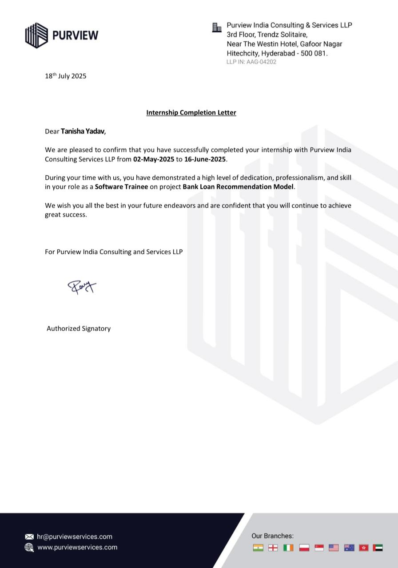

Slide 29
Thank you

